Slide 1
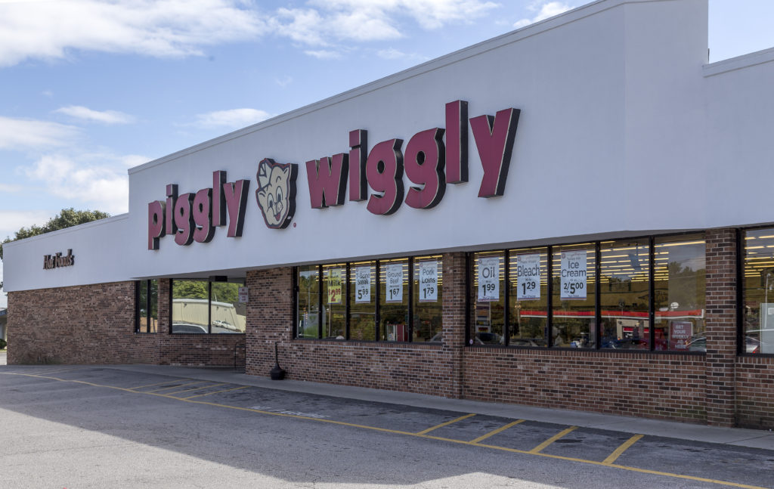
A trip to the Grocery Store

Slide 2
Let’s talk about last week.
Do you remember who lives on the forest floor?
Do you remember any of the advance words?
Tell me what types of animals you found on your safari hunt.

Slide 3
Tell me about the last time you went to the Grocery Store.

Slide 4
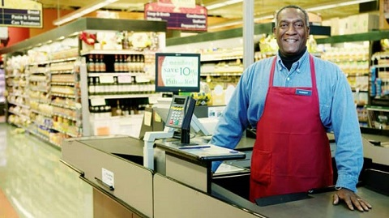
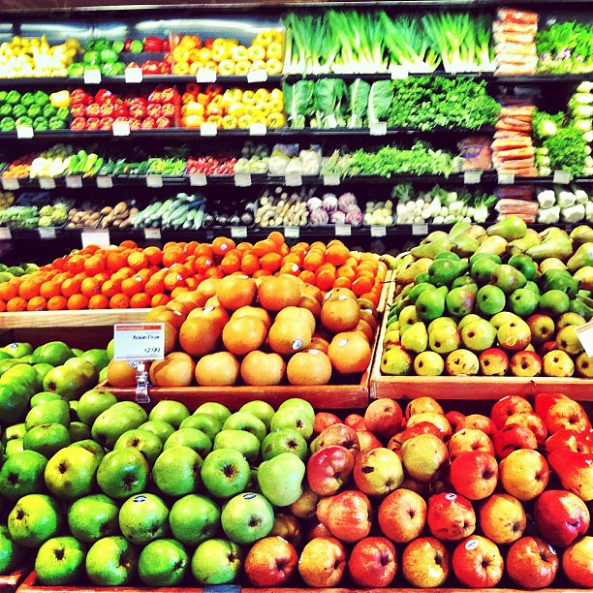
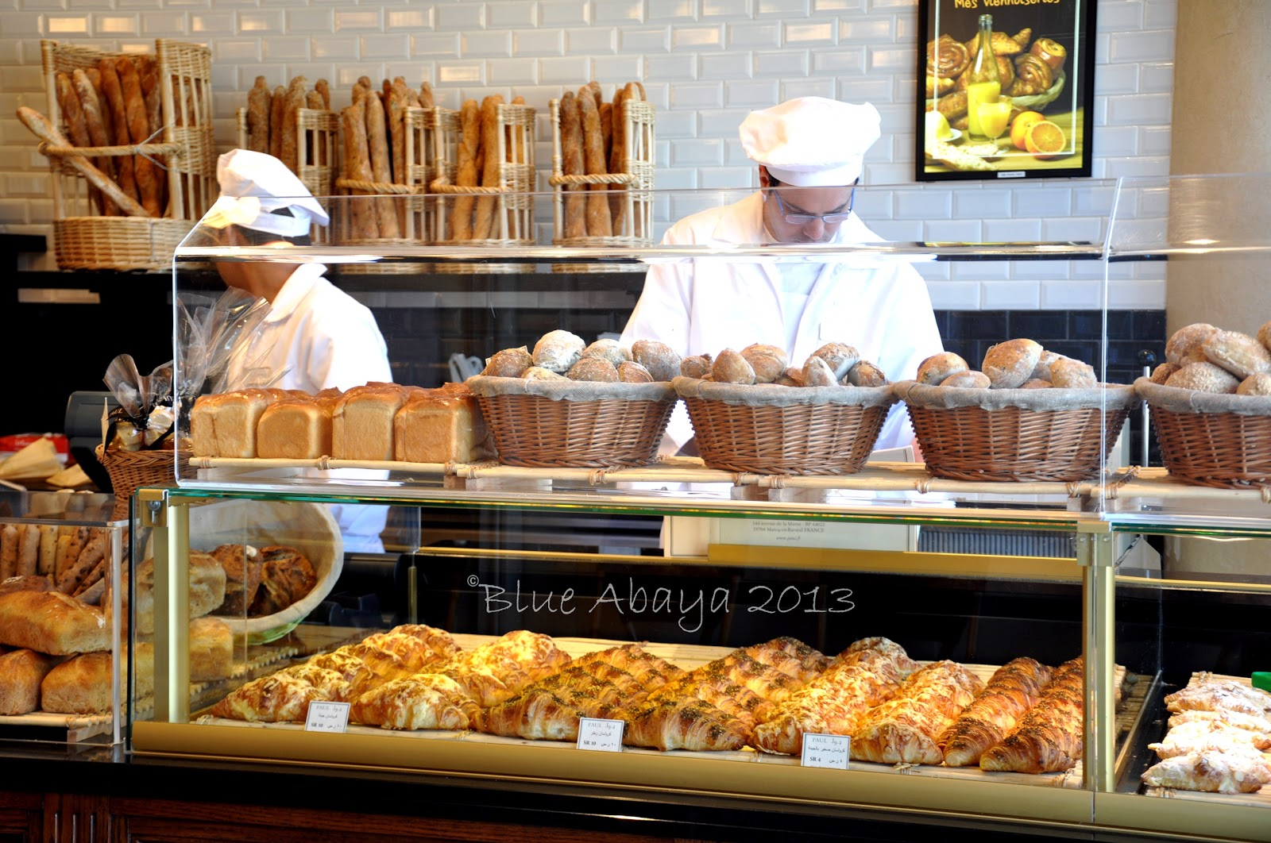
What do you think we will find in the Grocery Store?
Cashier
Fruits and Vegetables
Produce Section
Grocery Store
Bakery

Slide 5
It’s Story Time
https://www.youtube.com/watch?v=J7sSpBxJDrc

Slide 6
Advance Words

Slide 7
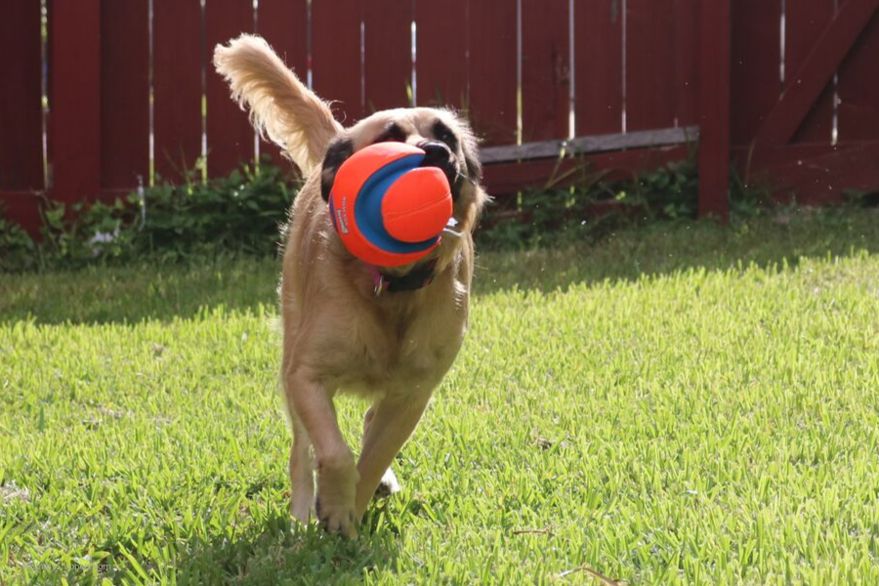
Fetch – to go for and then bring back.

Slide 8
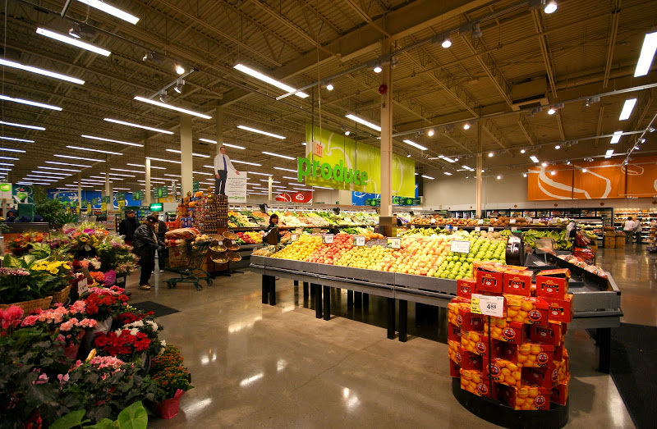
Supermarket – a large self-service store selling foods and household goods.

Slide 9
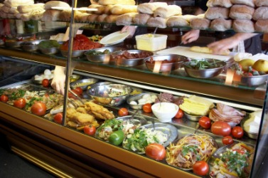
Delicatessen – a store selling cold cuts, cheeses, and a variety of salads.

Slide 10
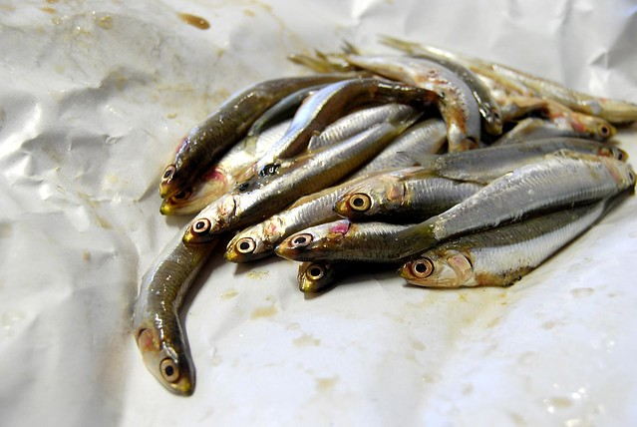
Anchovies – a small shoaling fish that is strongly flavored and preserved in salt and oil.

Slide 11
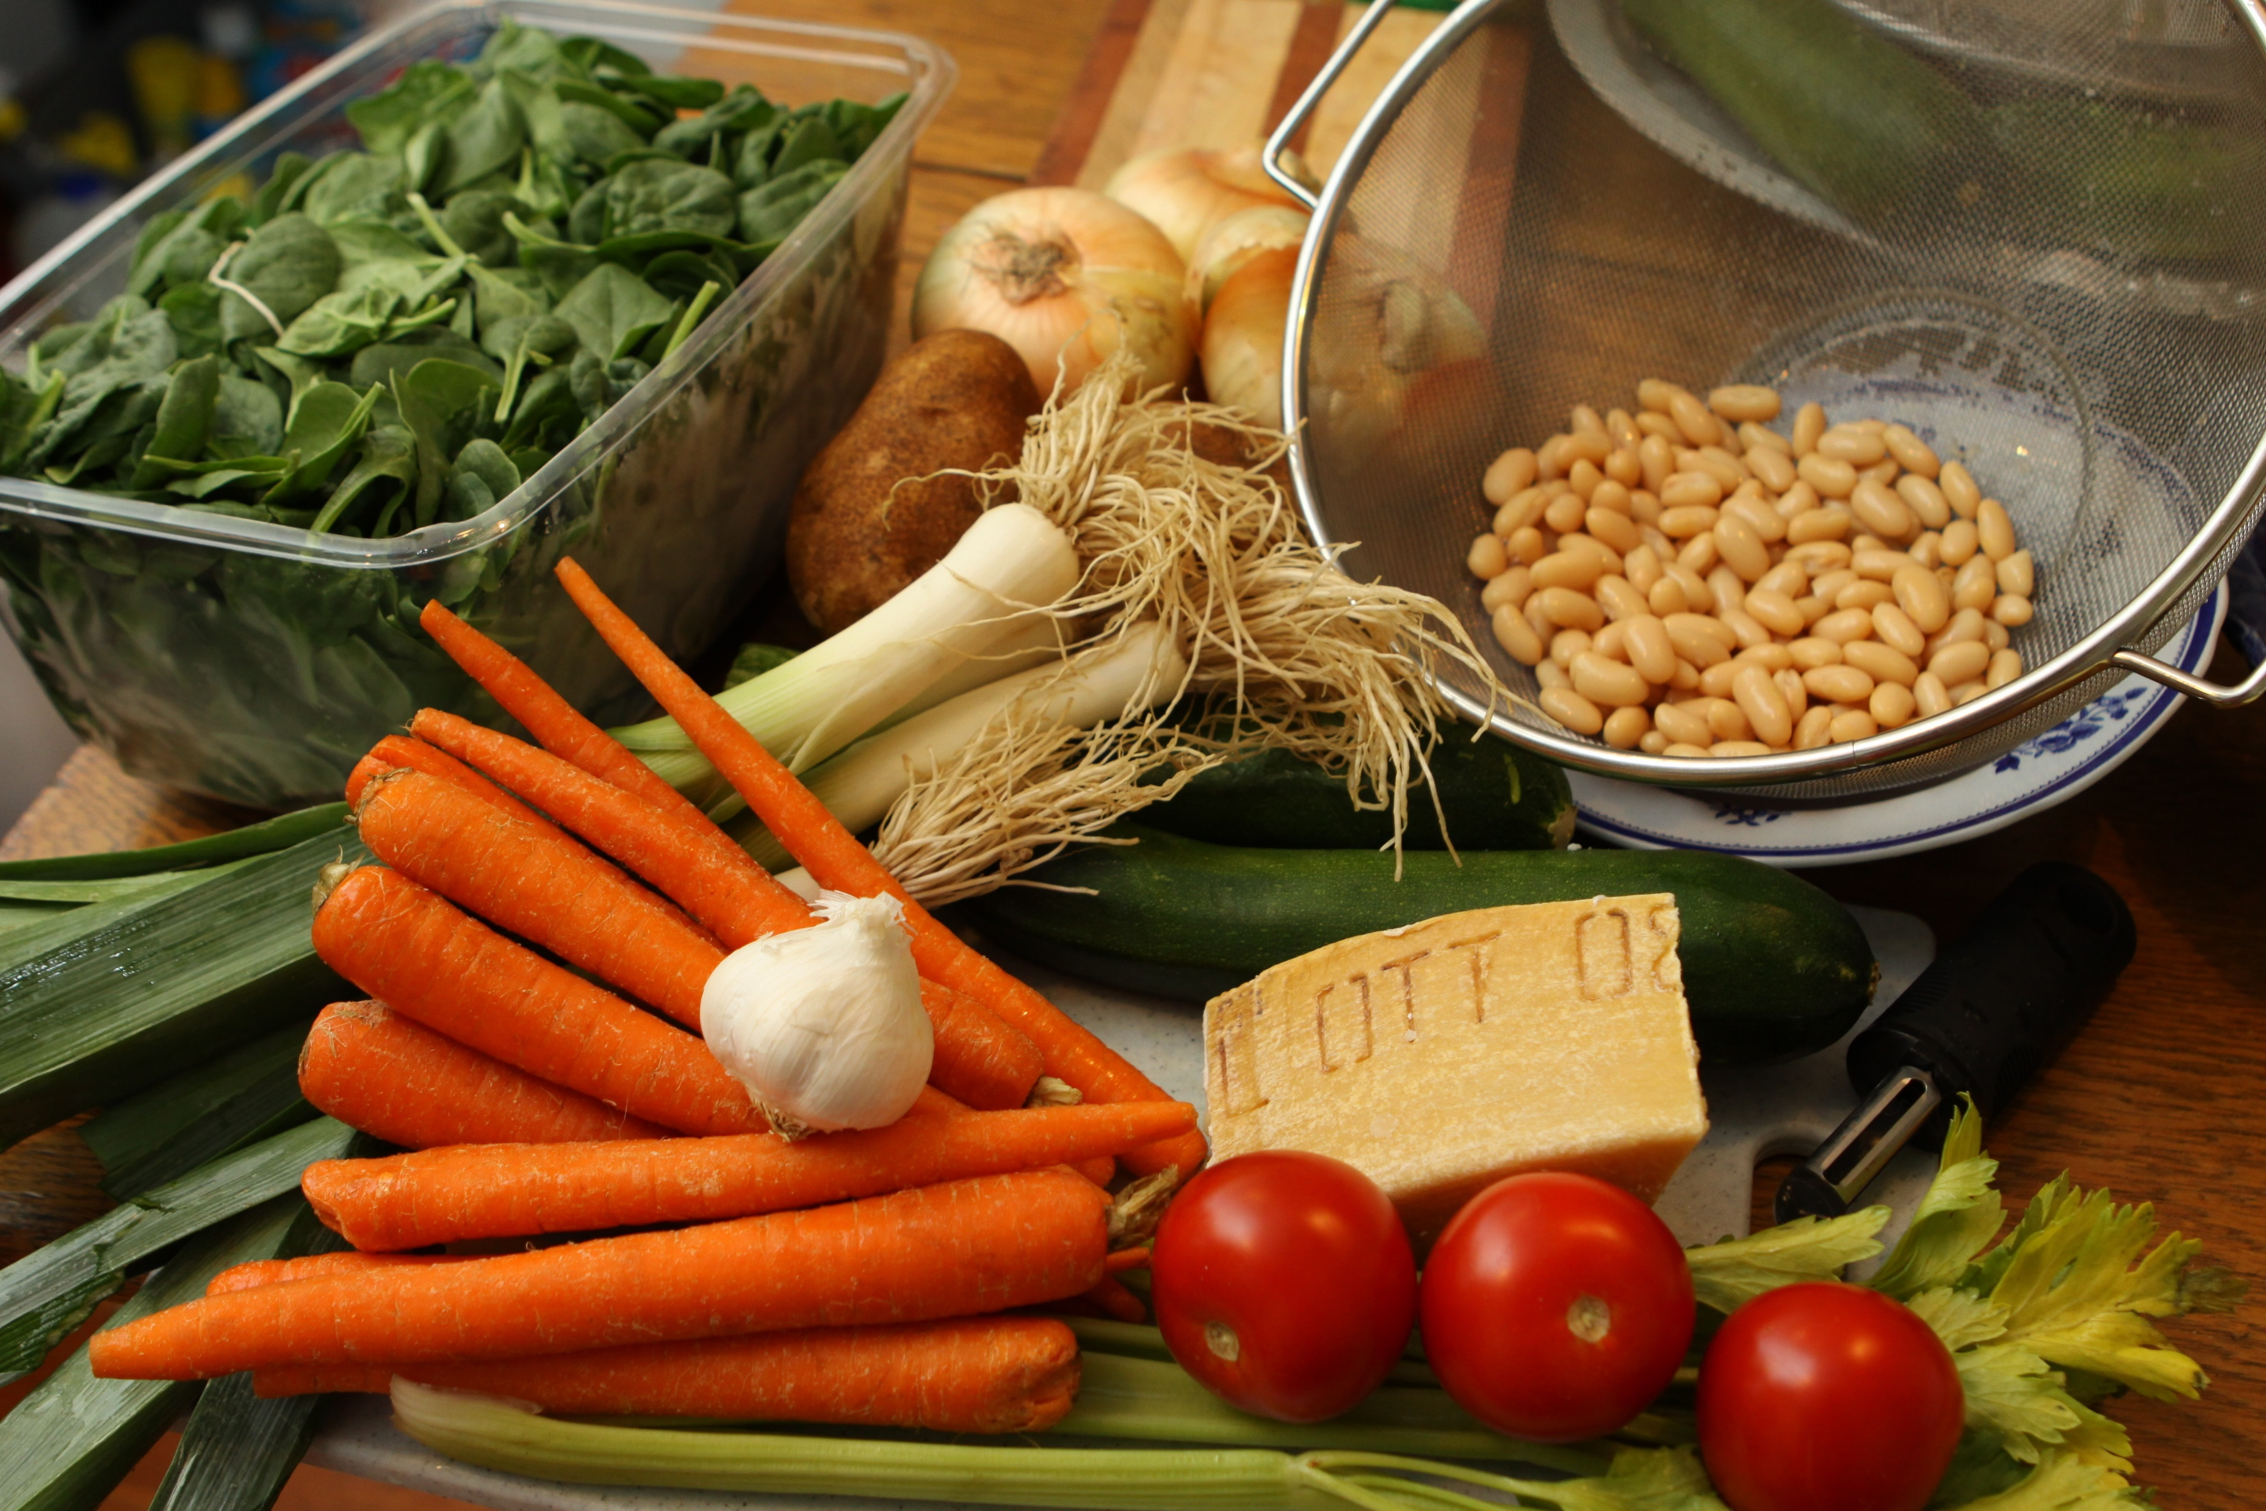
Ingredients – is a substance that forms a part of a mixture or recipes.

Slide 12
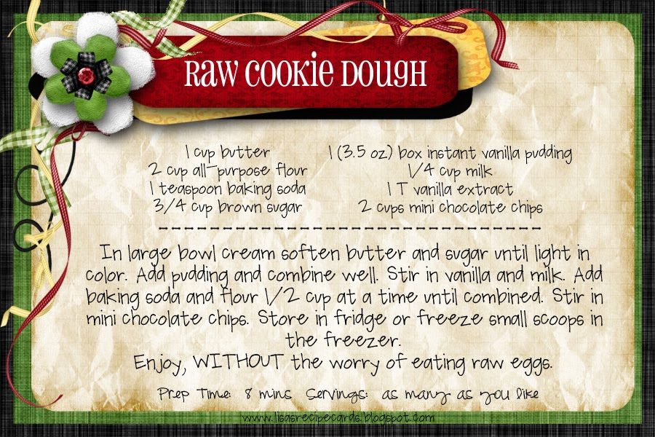
Recipes – is a set of instructions that describe how to prepare or a dish.

Slide 13
Book Reflections
How do you think we can make a pizza?
What ingredients will we need to make your favorite pizza?
Where do you think she can get a pizza pan?
How much do you think a pizza pan cost?
Compare some of items in the book to what you have at home.
Why is important to help others?

Slide 14
Family Activities

Slide 15
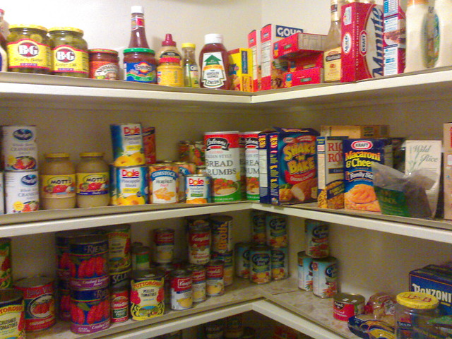
Let’s Take Inventory
Family Inventory
Item | How Many
Cereal
Cans of Corn
Cans of String Beans
Boxes of Noodles
Sugar
Flour
Eggs
This activity the family will go their refrigerator, cabinet or pantry. All the child to look at the can goods, cereal boxes, etc.. All the child to count the different items and take inventory of the items in the pantry.
Have fun! Make your own list!

Slide 16
Create a Grocery List
After you have taken inventory of the items in the refrigerator, cabinet or panty. Create a grocery list. Allow the child to help you write done the items you need before you go to the grocery store.
Go to www.couponmom.com and look for some of the items you need on your grocery list and find the coupon. This is a great matching game and a way to save some money.

Slide 17
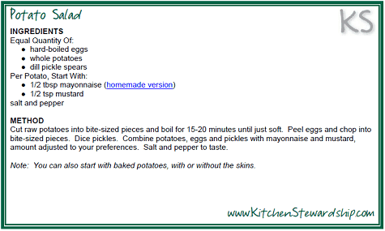
Create a Family Recipe
Let’s talk about your favorite meal. Now lets think about the different ingredients that we need to create this recipe.
Let’s write down or use the store adds to cut out the ingredients you need to make your favorite meal.

Slide 18
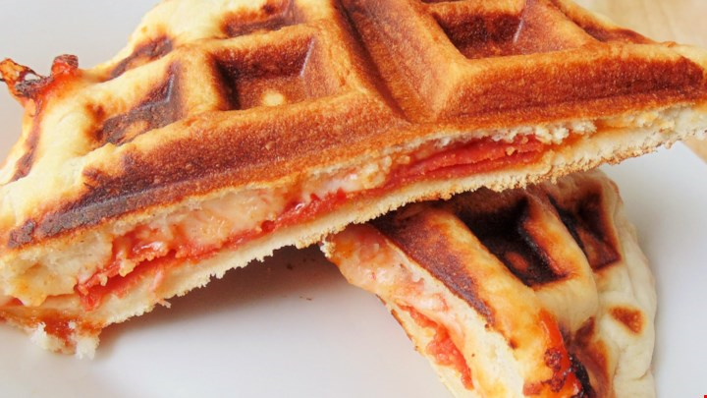
Family Fun Recipes
1 pound pizza dough
1/2 cup pizza sauce, divided
1 cup shredded mozzarella cheese, divided
16 slices pepperoni
Directions
Prep 10 m Cook 3 m Ready In 13 m
Preheat a waffle iron according to manufacturer's instructions.
Roll pizza dough to 1/2-inch thickness on a flat work surface. Cut dough into 16 rounds using a 2-inch cutter. Press rounds out with your fingers until each measures about 3 inches across.
Spoon 1 teaspoon pizza sauce into the center of 8 rounds. Top each with 2 teaspoons mozzarella cheese and 1 slice of pepperoni. Cover with remaining 8 rounds, pressing around edges to seal.
Cook the sealed rounds, in batches, on the preheated waffle iron until lightly browned, about 2 minutes. Top each one with another pepperoni slice and a little more mozzarella cheese. Close waffle iron and continue cooking until golden brown, 1 to 2 minutes more.

Slide 19
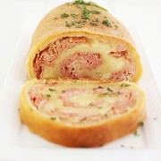
Ingredients:
1 ball pizza dough
8 oz. thinly sliced deli ham
1 cup shredded mozzarella cheese
Directions:
Preheat oven to 400 degrees F. Roll out pizza dough on a lightly floured surface. Press to form a 12 x 8-inch rectangle.
Arrange ham slices evenly over dough to within 1/2 inch of edges. Sprinkle evenly with cheese. Starting at one of the short ends, roll up dough to form log. Pinch seam together to seal. Place, seam side down, on a greased baking sheet.
Bake for 50 minutes, or until deep golden brown. Let stand 10 minutes before cutting into 8 slices with a serrated knife.
Serve with mustard or horseradish sauce, if desired.
Enjoy!
TIP

Slide 20
Let’s Calm Down and Relax
https://www.youtube.com/watch?v=Q5u2Ddbvocc

Slide 21
Family Time
How are doing?
Are you keeping the children’s on a daily schedule?
Set a side a small space in the house for your child/children to complete their school work.
Remember to take a few minutes a day just for you. Relax and keep calm.
Any questions for me?

Slide 22
Additional Resources
https://www.youtube.com/watch?v=8hLA5NYYB0s
Shopping with Dad
https://www.ixl.com
Personalize activities for children and children with disabilities.
www.funbrain.com
Free online books and activities for children.

Slide 23
Reference
The Comfort Cook Book. 2010. http://www.thecomfortofcooking.com/2014/05/3-ingredient-baked-ham-and-cheese-rollups.html
www.youtube.com
https://www.youtube.com/watch?v=Q5u2Ddbvocc – Spa relaxation music
https://www.youtube.com/watch?v=J7sSpBxJDrc - Little Red Hen Pizza

